Slide 1
Lecture 1
Digital and Analog Quantities
Logic Levels and Basic Logic Functions
Decimal Number System
Binary Number System
Hexadecimal Number System
Conversion of various number system to Decimal Number System

Slide 2
Digital and Analog Quantities
Electronic circuits can be divided into two broad categories,
Digital
Analog
Analog quantity is one having continuous values. A digital quantity is one having a discrete set of values.

Slide 3
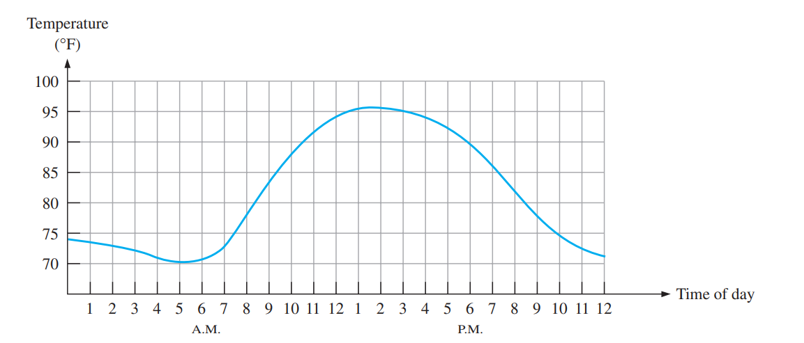
Example - Temperature
During a given day, temperature changes over a continuous range of values. The temperature does not go from, say, 70 to 71 instantaneously; it takes on all the infinite values in between. If you graphed the temperature on a typical summer day, you would have a smooth, continuous curve shown below
Other examples of analog quantities are time, pressure, distance, and sound.

Slide 4
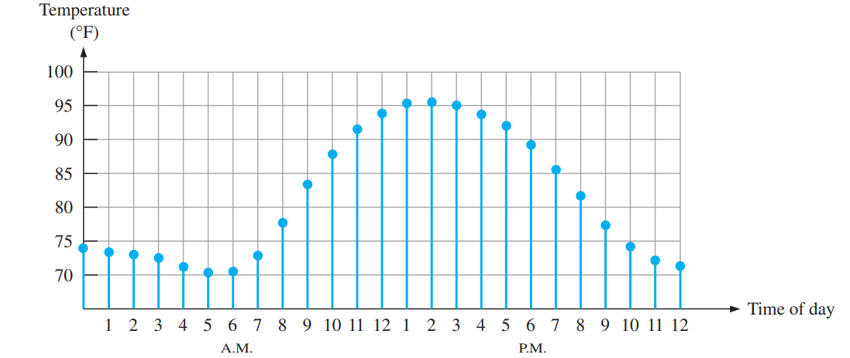
Example - Temperature - Contd
If we take a temperature reading every hour rather than graphing continuously. Then it will result in sampled values representing the temperature at discrete points in time (every hour) over a 24-hour period.
You have effectively converted an analog quantity to a form that can now be digitized by representing each sampled value by a digital code.

Slide 5
The Digital Advantage
Digital representation has certain advantages over analog representation in electronics applications.
digital data can be processed and transmitted more efficiently and reliably than analog data.
digital data has a great advantage when storage is necessary. For example, music when converted to digital form can be stored more compactly and reproduced with greater accuracy and clarity than is possible when it is in analog form. Noise (unwanted voltage fluctuations) does not affect digital data nearly as much as it does analog signals.

Slide 6
Binary Digit
Each of the two digits in the binary system, 1 and 0, is called a bit, which is a contraction of the words binary digit.
Generally, 1 is represented by the higher voltage, which we will refer to as a HIGH, and a 0 is represented by the lower voltage level, which we will refer to as a LOW.
HIGH = 1 and LOW = 0
Groups of bits (combinations of 1s and 0s), called codes are used to represent numbers, letters, symbols, instructions, and anything else required in a given application.

Slide 7
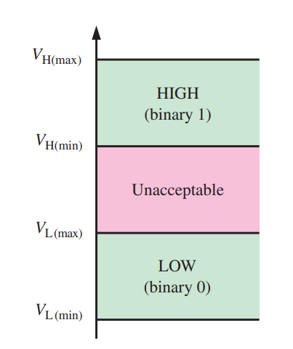
Logic Levels
The voltages used to represent a 1 and a 0 are called logic levels.
Example
For a certain Digital Circuit Technology
HIGH input values may range from 2 V to 3.3 V
LOW input values may range from 0 V to 0.8 V
If a voltage of 2.5 V is applied, the circuit will accept it as a HIGH or binary 1.
If a voltage of 0.5 V is applied, the circuit will accept it as a LOW or binary 0.
Voltages between 0.8 V and 2 V are unacceptable

Slide 8
Basic Logic Functions
In its basic form, logic is the realm of human reasoning that tells you a certain proposition (declarative statement) is true if certain conditions are true.
Propositions can be classified as true or false.
Many situations and processes that you encounter in your daily life can be expressed in the form of propositional, or logic, functions.
Since such functions are true/false or yes/no statements, digital circuits with their two-state characteristics are applicable.
Example: the propositional statement “The light is on” will be true if “The bulb is not burned out” is true and if “The switch is on” is true.
Logical statement can be made: The light is on only if the bulb is not burned out and the switch is on. In this example the first statement is true only if the last two statements are true.

Slide 9

Basic Logic Functions - Contd
The term logic is applied to digital circuits used to implement logic functions.
Several kinds of digital logic circuits are the basic elements that form the building blocks for such complex digital systems as the computer.
Three basic logic functions
NOT,
AND and
OR
The lines connected to each symbol are the inputs and outputs.
The inputs are on the left of each symbol and the output is on the right.
A circuit that performs a specified logic function (AND, OR) is called a logic gate.

Slide 10

NOT- Logic Gate
The NOT function changes one logic level to the opposite logic level.
When the input is HIGH (1), the output is LOW (0).
When the input is LOW, the output is HIGH.
The NOT function is implemented by a logic circuit known as an inverter.

Slide 11
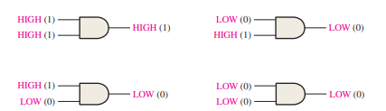
AND- Logic Gate
The AND function produces a HIGH output only when all the inputs are HIGH, for the case of two inputs.
When one input is HIGH and the other input is HIGH, the output is HIGH.
When any or all inputs are LOW, the output is LOW.

Slide 12
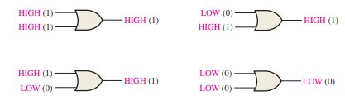
OR - Logic Gate
The OR function produces a HIGH output when one or more inputs are HIGH, for the case of two inputs.
When one input is HIGH or the other input is HIGH or both inputs are HIGH, the output is HIGH.
When both inputs are LOW, the output is LOW. The OR function is implemented by a logic circuit known as an OR gate.

Slide 13

Decimal Number System
In the decimal number system each of the ten digits, 0 through 9, represents a certain quantity
A decimal number such as 7,392 represents a quantity equal to 7 thousands, plus 3 hundreds, plus 9 tens, plus 2 units.
Shorthand Notation
7 * 10³ + 3 * 10² + 9 * 10¹ + 2 * 10⁰
The position of each digit in a decimal number indicates the magnitude of the quantity represented and can be assigned a weight.

Slide 14
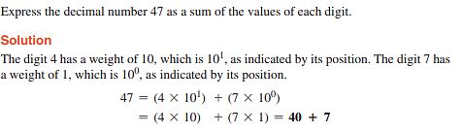
Decimal Number System – Example 1

Slide 15
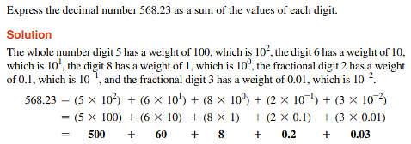
Decimal Number System – Example 2

Slide 16

Binary Number System
The binary number system is another way to represent quantities.
It is less complicated than the decimal system because the binary system has only two digits.
The decimal system with its ten digits is a base-ten system; the binary system with its two digits is a base-two system. The two binary digits (bits) are 1 and 0.
The weights in a binary number are based on powers of two.
The right-most bit is the LSB (least significant bit) in a binary whole number. The weights increase from right to left by a power of two for each bit. The left-most bit is the MSB (most significant bit); its weight depends on the size of the binary number.

Slide 17
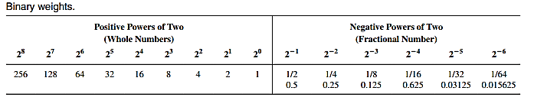
Binary Weights
Values in Decimal Number System

Slide 18
Hexadecimal Number System
The hexadecimal number system has a base of sixteen.
It is composed of 16 numeric and alphabetic characters.
Hex is useful because large numbers can be represented using fewer digits. For example, colour values and MAC addresses are often represented in hex. Additionally, hex is easier to understand than binary. Programmers often use hex to represent binary values as they are simpler to write and check than when using binary.

Slide 19
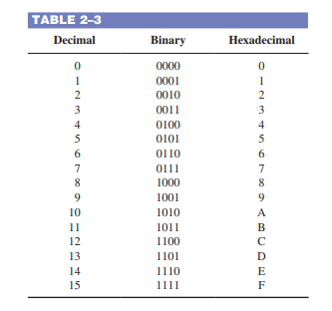
Hexadecimal Number System – Comparison Chart

Slide 20
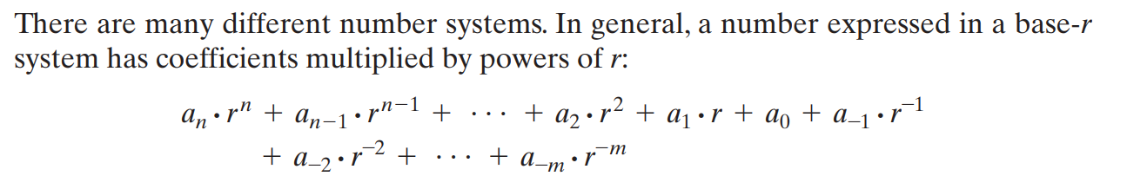
General Shorthand Number System Notation

Slide 21
Conversion - Number Systems to Decimal
Binary Number System
Hexadecimal Number System

Slide 22
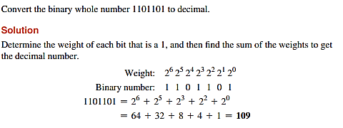
Binary-to-Decimal Conversion – Example 1

Slide 23
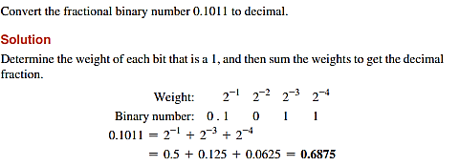
Binary-to-Decimal Conversion – Example 2

Slide 24
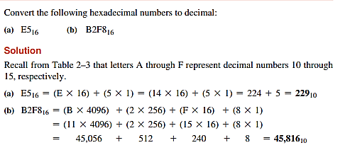
Hexadecimal-to-Decimal Conversion- Example

Slide 25
Tasks
Octal Number System - its construction, shorthand notation and conversion to decimal number system
Revise the conversion method of Decimal Number System to Binary and Decimal Number System to Hexadecimal System

